Slide 1
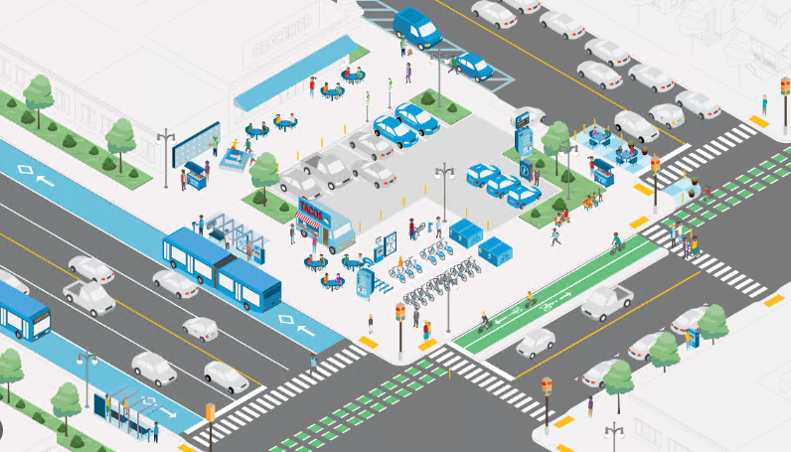


Planning Location of Mobility Hubs in Gainesville, FL
‘Kelly’ Anran Zheng
Master Student in Transportation Engineering
University of Florida
Notes:
Source: https://mtc.ca.gov/sites/default/files/Intro_MTC%20Mobility%20Hub%20Implementation%20Playbook_4-30-21.pdf

Slide 2

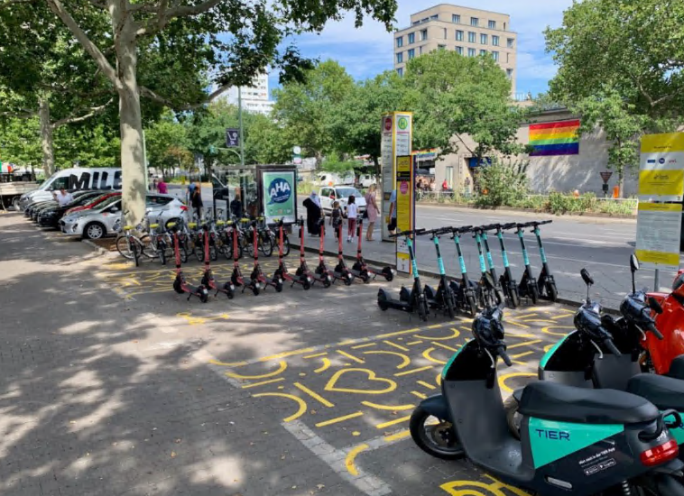
What are mobility hubs?
A platform where people can connect to multiple modes of transportation to make their trip safe, convenient and reliable.
A sketch of a mobility hub that integrates public transit and shared micromobility (Source: CoMoUK, 2021)
Example: A small mobility hub in Berlin (Source: Traif, 2021)
Notes:
Mobility hub could be a platform and can provide multimodal transportation options and service, and better facilitate people’s travel experiences.

Slide 3




Why need to site mobility hubs?
Provide transit supply and serve multimodal travel needs
Enhance first-/last-mile connectivity and facilitate transfers
Achieve equitable accessibility for all people
An ideal mobility hub should include these features (Source: City of Boston)

Slide 4
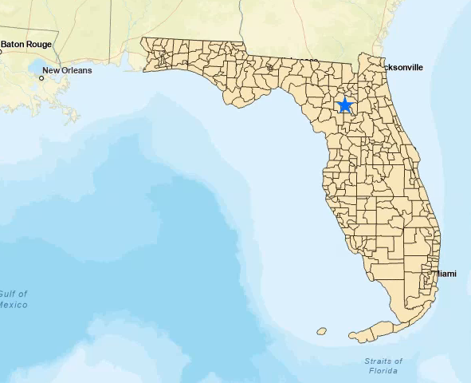
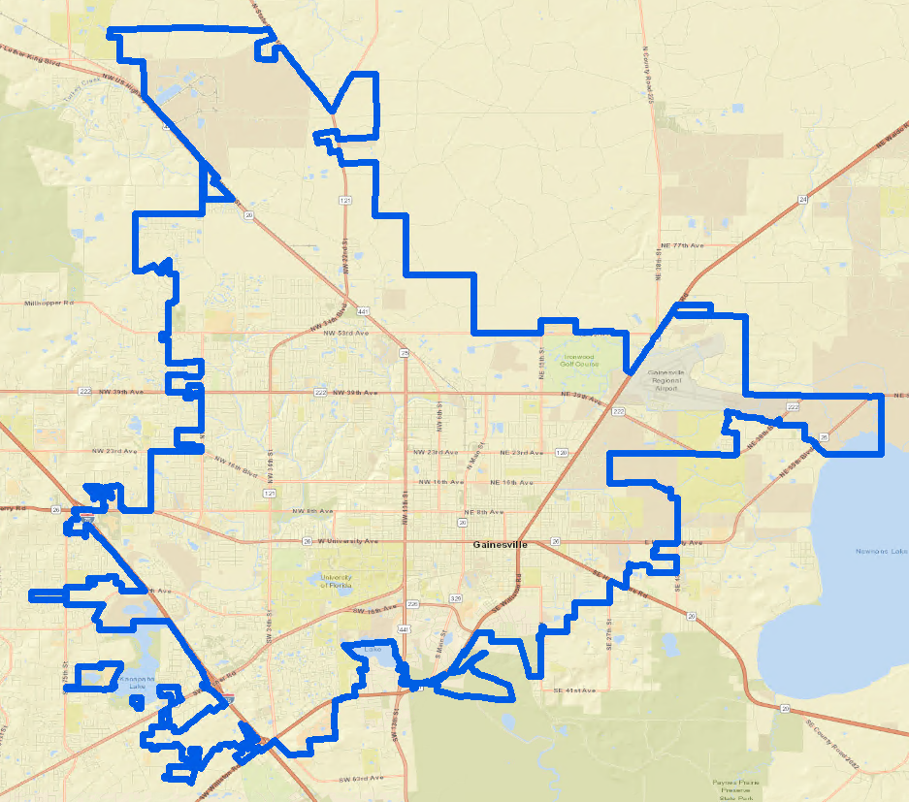
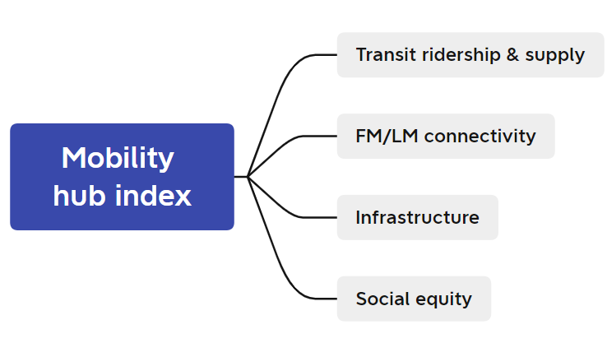
Project Objectives
To develop a GIS-based analytical framework for Florida agencies to decide the optimal locations of mobility hubs
We take Gainesville, FL as case study region but will apply the methodology framework to other regions in the future analysis (e.g Jacksonville, West Palm beach).
Four criteria in deciding mobility hubs

Slide 5
Dataset
Criteria | A. Transit ridership and supply |  | C. Infrastructure | D. Sociodemographic Characteristics
Datasets | Bus Ridership Bus Stops Bus Service Frequency Bus routes | Micromobility (scooter, microtransit, bikeshare) FM/LM trips | Sidewalk Bicycle lane | Employment Population Race Education Vehicle ownership Income
Data sources | City, transit agency, Florida Signal Four Analytics | City, Department of transportation | City, Google Maps | American Community Survey (ACS) , LEHD
B. FM/LM Connectivity

Slide 6
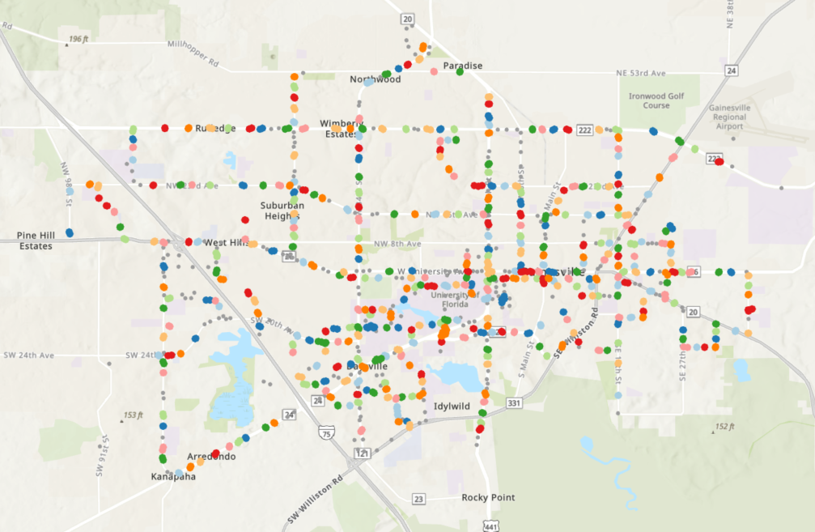
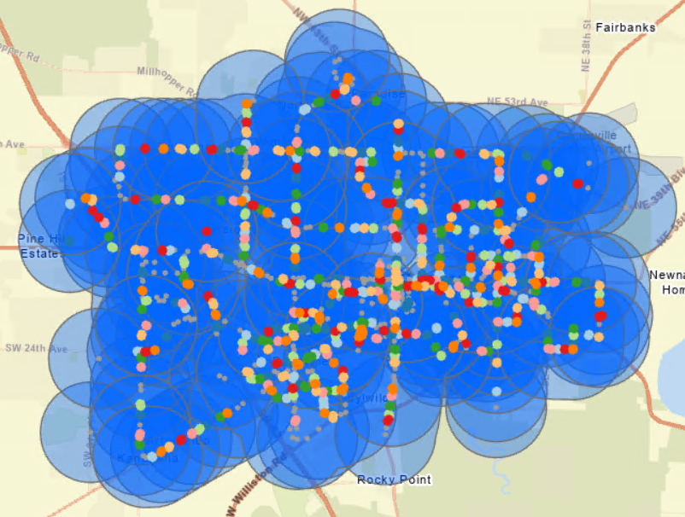
Methodology
Step 1: define the spatial unit for locating mobility hubs
Group adjacent transit stops
Create 1 mi buffers around transit-stop clusters
DBSCAN clustering algorithm: generate 628 grouped clusters among 1081 stops
Spatial unit to identify mobility hubs
Notes:
The first step is to define a spatial unit for locating mobility hubs. We believe that mobility hubs should be sited within about 1 mile buffer from groups of adjacent transit stops. Then we define this as spatial unit in our analysis.
Density-based Clustering in ArcGIS Pro: (https://pro.arcgis.com/en/pro-app/3.0/tool-reference/spatial-statistics/how-density-based-clustering-works.htm)
Defined distance (DBSCAN)—Uses a specified distance to separate points into clusters. I set the search distance as 100m. The number of bus stops per cluster is 1-10.
Why 1 mile buffer? Currently we assume all the mobility hubs in Gainesville are neighbourhood level. Passengers access to the mobility hubs through walking and bicycling.

Slide 7
Methodology
Sub-criteria
Z-score normalization
Criteria
Weights
Ridership
Service frequency
Transit ridership and supply
(Transit centrality score)
z
0.3
Micromobility FM/LM trips
z
FM/LM trips
(FM/LM connectivity score)
0.3
Mobility hub index
Bike lanes/sidewalks length
z
Supporting infrastructure
(Infrastructure readiness score)
0.2
Optimal locations & Number of mobility hubs
Race
Income
Education
Employment
Population
z
Socioeconomic considerations
(Transportation equity score)
0.2
Step 2: Compute the four scores for each spatial unit
Step 3: Compute mobility hub index by weighing each of four score
Notes:
Based on the data we collected, we aggregate them to the spatial unit and compute four scores of different criteria. Then assign different weights of these scores and integrate them to calculate the mobility hub index. Finally, rank this index to decide the optimal locations of mobility hubs.

Slide 8
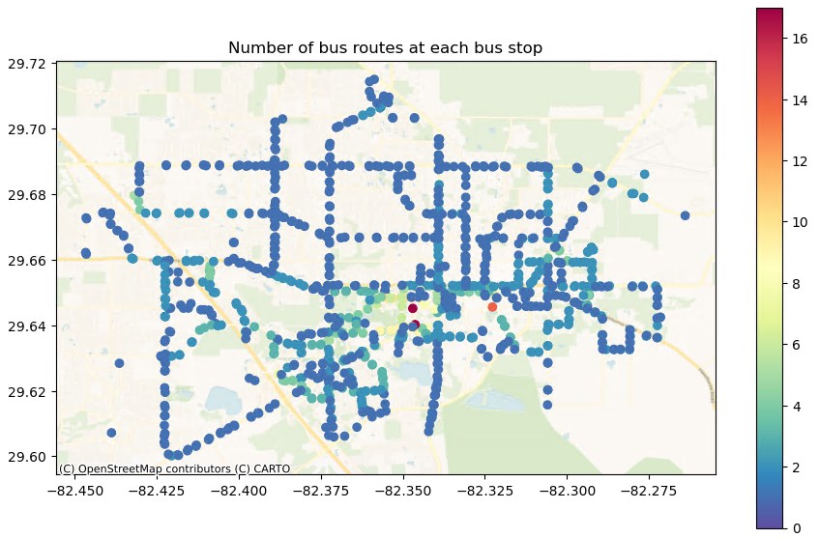
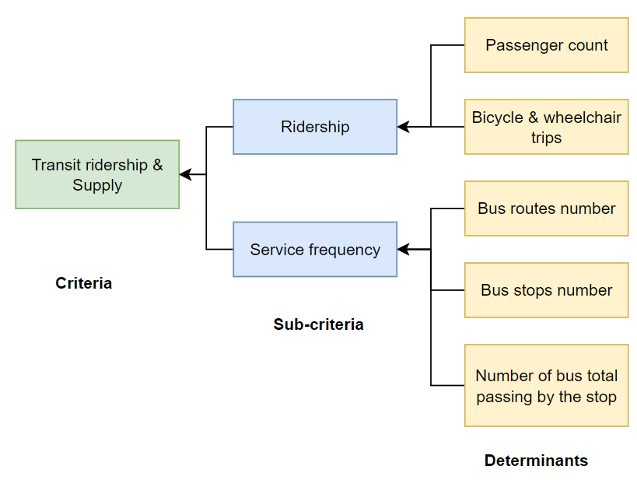
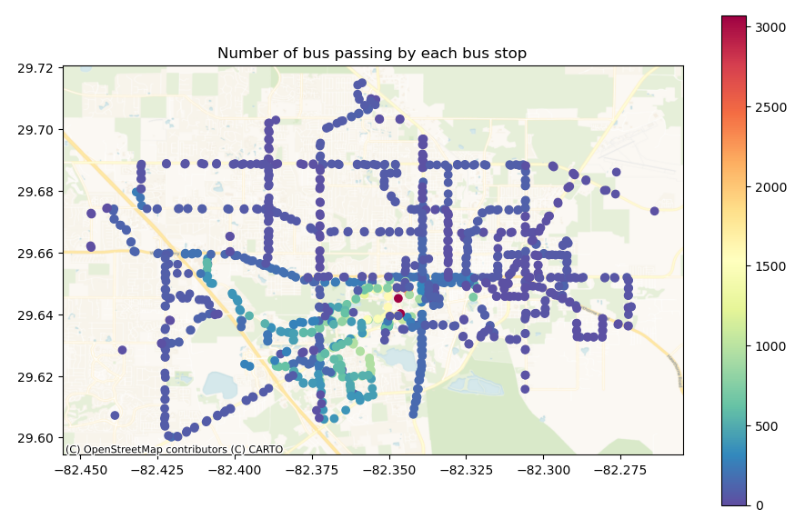
Criteria #1. Transit Ridership and Supply
The stop-level determinants should be aggregated to the spatial unit. (code)
Notes:
We consider four criteria in deciding the mobility hubs (transit ridership & supply, FMLM connectivity, infrastructure, social equity). Each criteria has several sub criteria, which involve different variables to be calculated.
The first criteria is about ridership and supply. This is decided by two sub criteria: ridership and service frequency. These determinants are all stop-level and need to be aggregated to the spatial unit: join based on the stop_id.

Slide 9
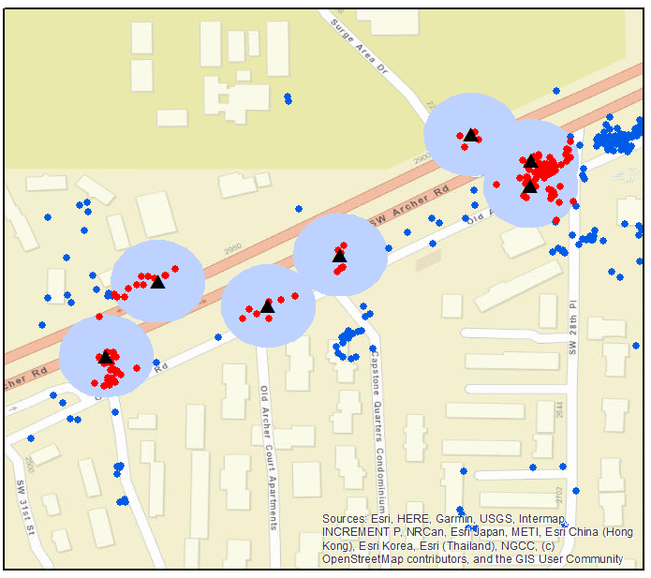
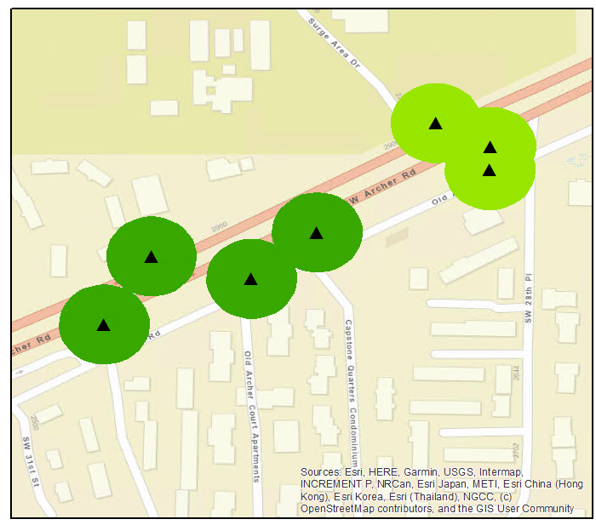
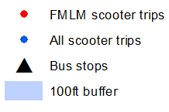
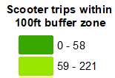

Criteria #2. First/last mile Connectivity
FM/LM connectivity score is measured by the micromobility trip origin/destination counts (scooter, microtransit, bikeshare) within 100ft buffer zone at the grouped bus stops.
Notes:
FMLM problems refer to the gap between transit stops and travellers’ origin/destination. Micromobility can solve the FMLM problems by enhancing the connectivity to transit stops. If more micromobility trips are around bus stops, then such bus stops have less serious FMLM problems.
We have the micromobility trip data, which includes trip origin/destination information.
select the scooter number within the buffer
assign the selection to the spatial unit

Slide 10
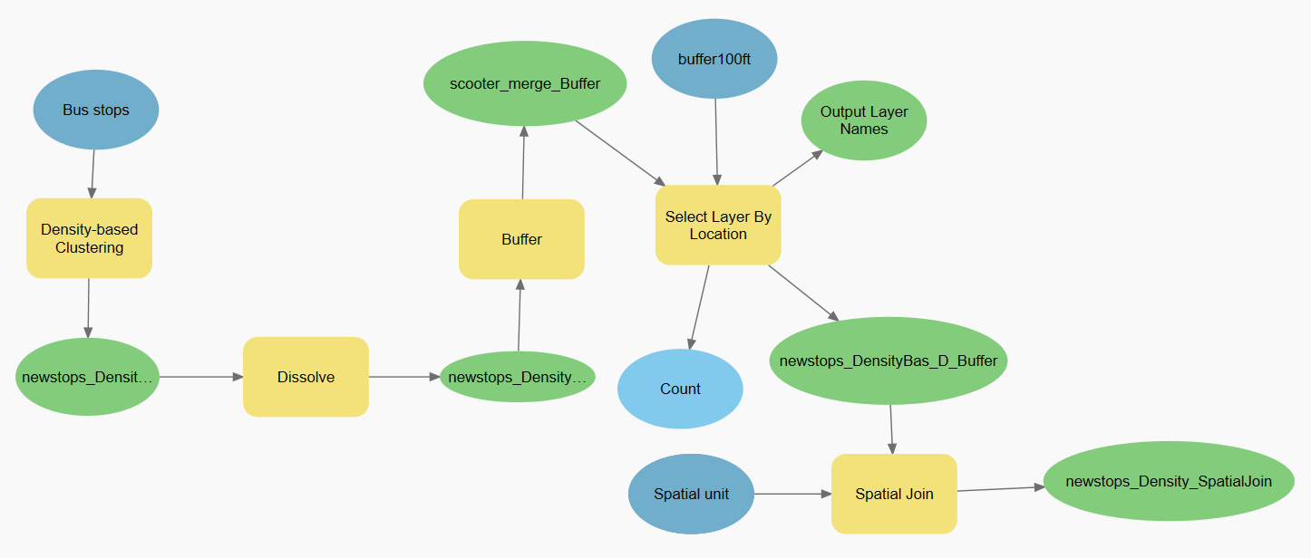
Criteria #2. First/last mile Connectivity
Step2: select the scooter number within the buffer
Step1: generate spatial unit
Step3: assign the selection to the spatial unit

Slide 11
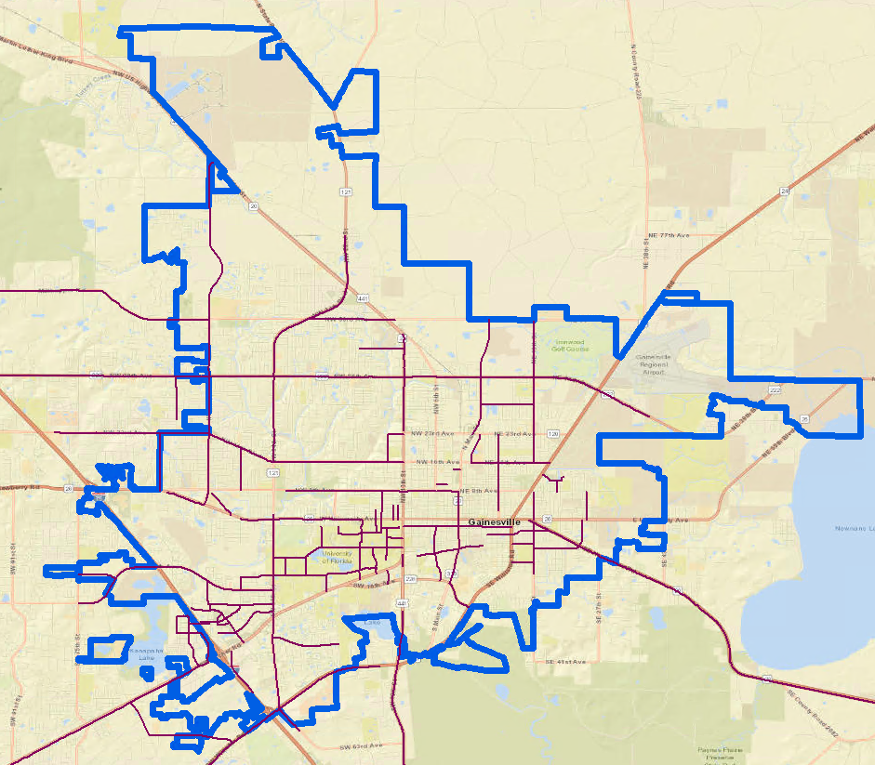
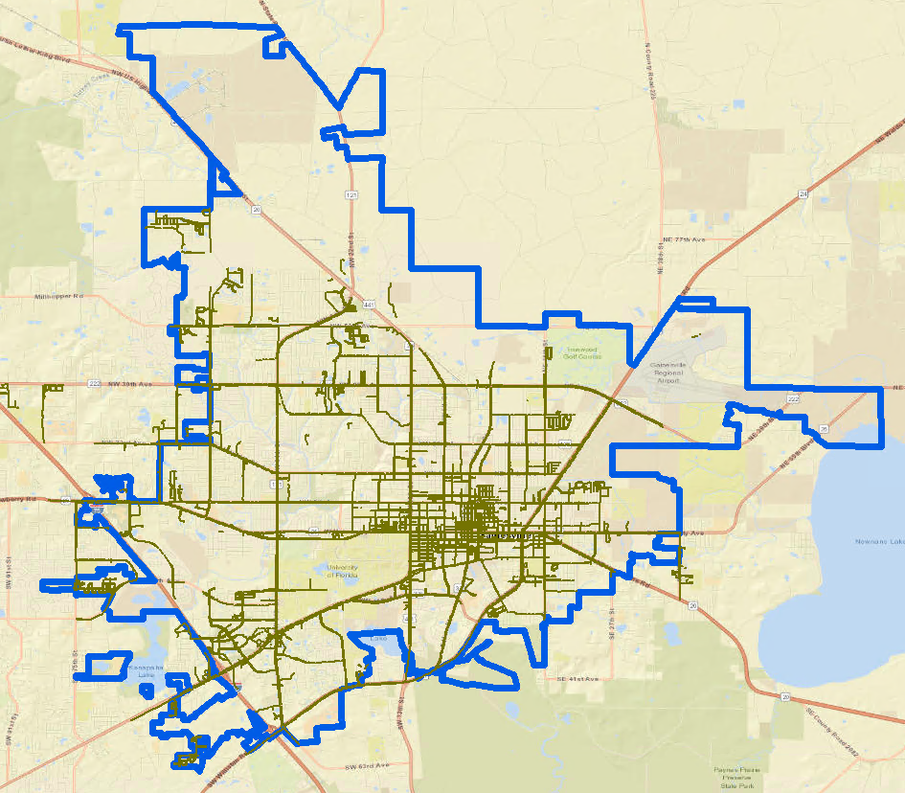
Criteria #3. Infrastructure
Infrastructure readiness score is measured by the sidewalk and bicycle length within the spatial unit.
Bike lanes Sidewalk
Notes:
Mobility hubs should also contain some infrastructure for pedestrian and cyclists.

Slide 12
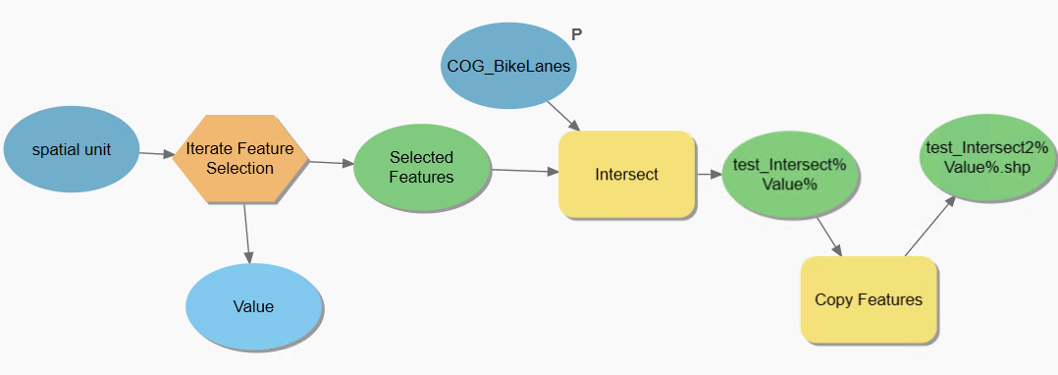
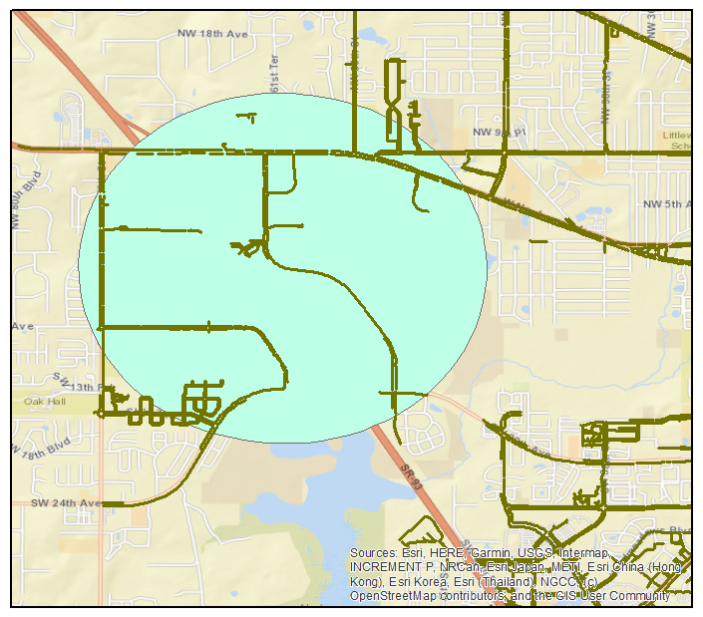
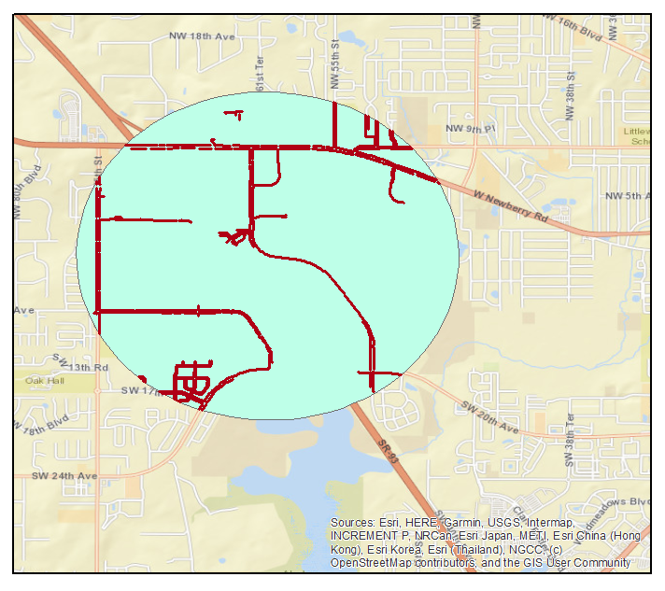
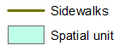
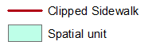
Criteria #3. Infrastructure
Module builder: clip the road segment by the spatial unit
Example

Slide 13
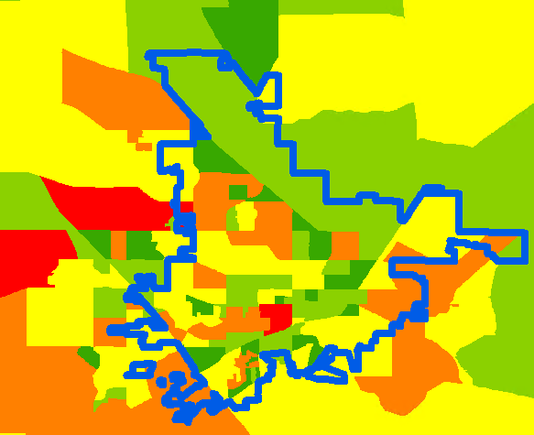
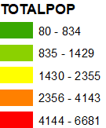
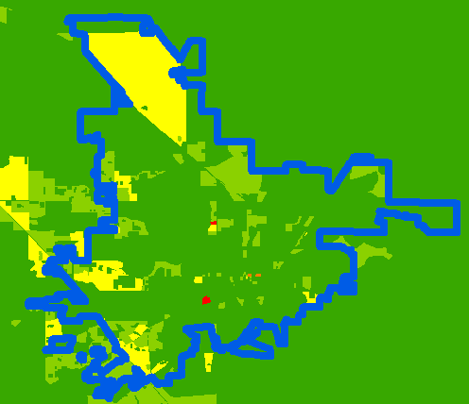
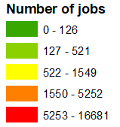
Criteria #4. Socioeconomic Factors
Considered factors:
Total population
Total high-income population (%)
Hispanic white population (%)
Household with zero vehicles (%)
Children & elderly (%)
Numbers of jobs
Number of high-wage jobs (%)
Notes:
Lastly, mobility hubs should solve social equity issues, making sure that even disadvantageous groups should access the mobility hubs.

Slide 14
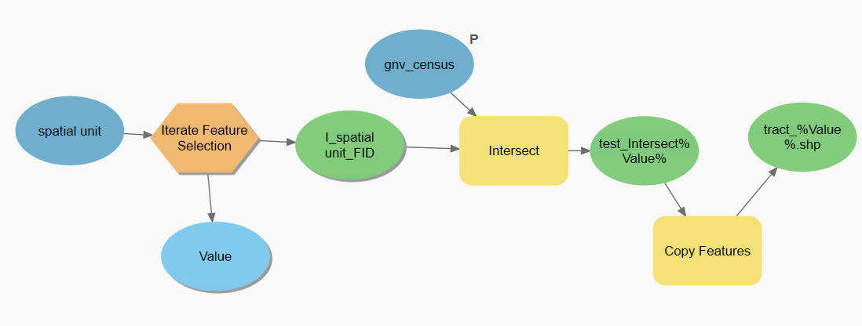
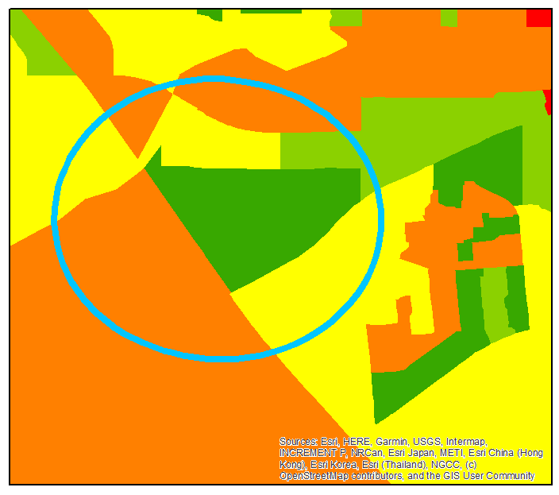
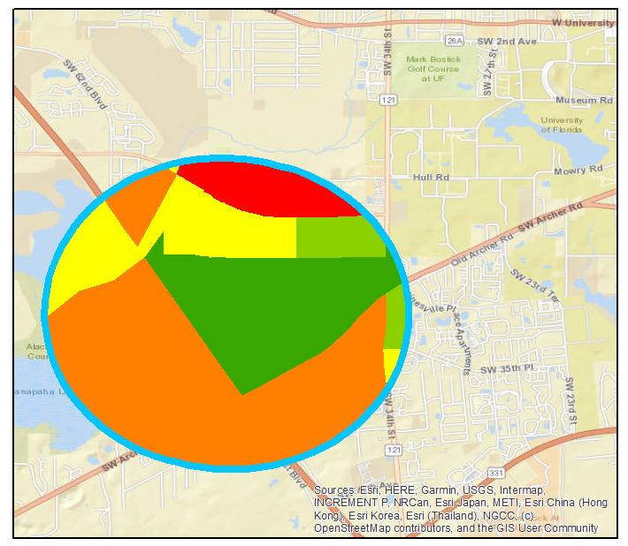
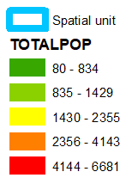
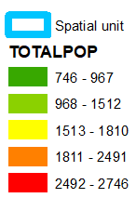
Criteria #4. Socioeconomic Factors
Module builder: intersect the census block group with each spatial unit to assign the sociodemographic information to the spatial unit
Example
Notes:
The sociodemographic data is census block group level and we also need to assign these values to the spatial unit through the intersect function in ArcGIS.

Slide 15
Future work
Continue calculating the spatial indicators for the infrastructure and socioeconomic factors (finished by this week):
Assign weights to different indicators through the discussion with stakeholders
Integrate all the weighted spatial indicators of different criteria. Calculate the mobility hub index to site mobility hubs.
Bicycle & sidewalk length within the spatial unit
Average population & number of jobs within the spatial unit
Notes:
This is still an on-going project. We plan to finish all the spatial analysis next month.

Slide 16
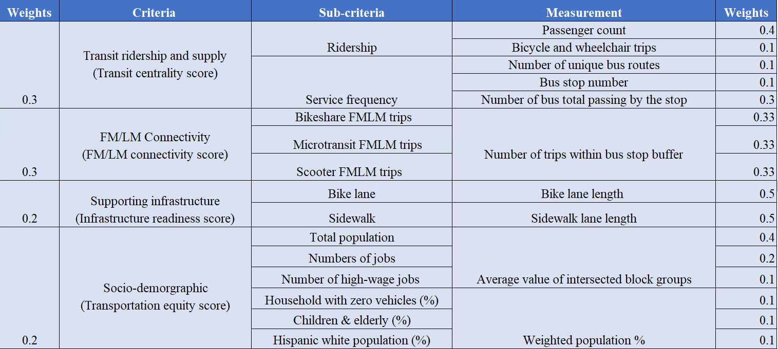
Initial thoughts of weighting scheme
Notes:
The weighting scheme should depend on different objectives and scenarios. In this project, our primary goal is to satisfy multimodal travel needs and improve FMLM connectivity. So I assign more weights to the transit ridership & supply, FMLM connectivity.

Slide 17
Thanks! Q&A
‘Kelly’ Anran Zheng
anranzheng@ufl.edu

